Slide 1
Real-Time Intelligence
In Microsoft Fabric

Slide 2




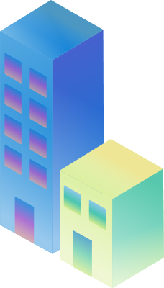
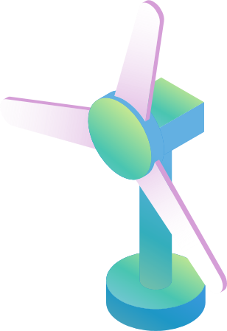
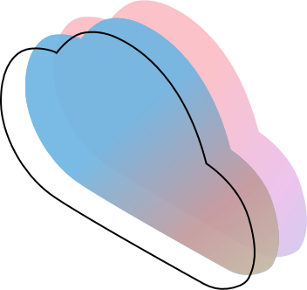

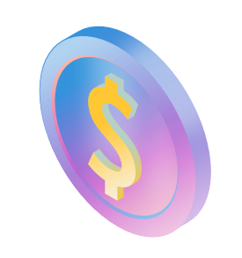
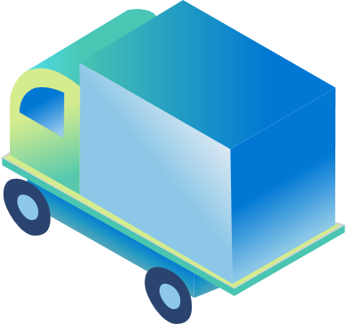

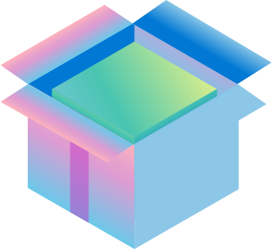
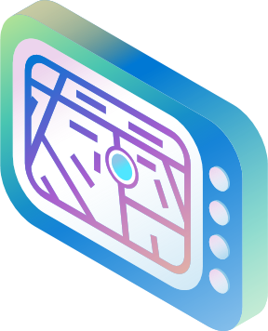
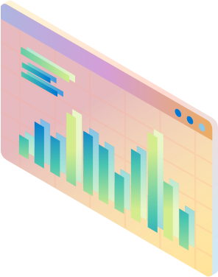


The world is exploding with event data & data in motion… How do you turn it into a competitive edge?
Notes:
Specific data examples
Call out not *just* “real time” – high volume high granularity
We see this everywhere in the world around us, there is an explosion of high granularity data in motion. There is data from Sensors, IOT devices, digital applications, business processes, all the telemetry, logs and more. And this data is generated in real time at high velocity and in huge volumes across thousands of sources!

Slide 3
Automotive
Manufacturing
Logistics
Finance & Insurance
Energy & Utilities
Retail
The negative impacts of stale data do not discriminate across industries
Poor decision-making
Financial loss
Reduced
operational efficiency
Impaired data integrity
Risk of non-compliance
Compromised user experience
Notes:
Or Take the energy sector for example: Wind farm operators need real-time signals from their equipment, this improves their asset efficiency and extract the maximum amount of renewable energy from the wind.

Slide 4

Manufacturing
Factory management
Development and testing
Connected Factory
Quality Control
Predictive maintenance
Energy Management
Carbon footprint
Logistics
Fleet management
Supply Chain
Demand management and forecasting
Shipping and distribution
Customer service
Manufacturing technology providers
Data driven continuous product improvement
Product embedded analytics
Notes:
If we look deeper into Manufacturing…
There are multiple examples like Factory Management or Logistics that benefit from Fabric Real Time Analytics
Allows to help with scenarios like Quality Control (data coming multiple sources, over large data set of high granularity data) allows multiple people in the organization to collboarte and get the insights and drive actions on GRANULARITY data points.

Slide 5
Automotive
Manufacturing
Logistics
Finance & Insurance
Energy & Utilities
Retail
Connected fleet applications
Autonomous Driving
Manufacturing + R&D
Improving Quality and Throughput
Predictive Maintenance
Inventory Prediction
Delivery tracking and routing
Warehouse management
Supply & demand operations
Finance Automation
Fraud Detection
Operational Efficiency
Station monitoring, energy leakage detection
Equipment Maintenance & Monitoring
Failure Monitoring
Inventory tracking
Promotions and buying experiences
Supply chain management
Notes:
Or Take the energy sector for example: Wind farm operators need real-time signals from their equipment, this improves their asset efficiency and extract the maximum amount of renewable energy from the wind.

Slide 6
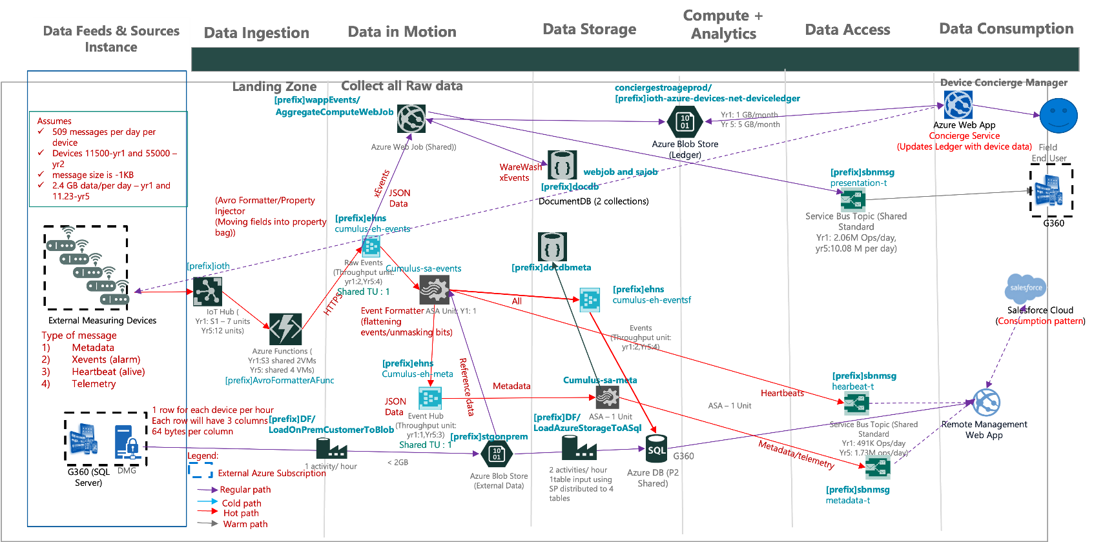
Hard to build real-time solutions today

Slide 7
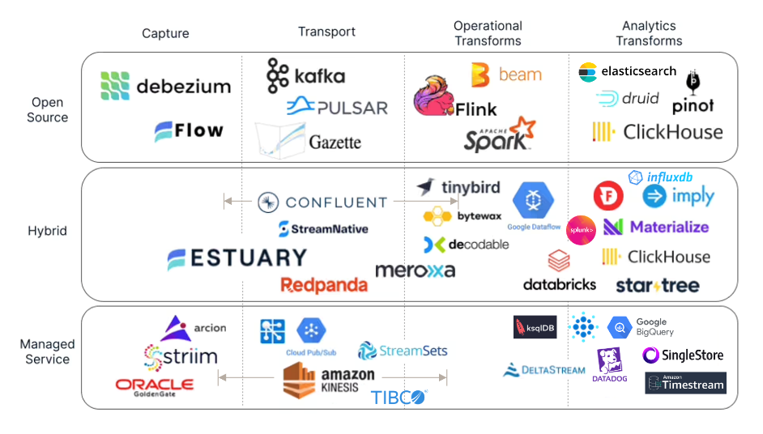
Fragmented landscape for real-time data

Slide 8

Companies need a unified platform for developing real-time data solutions
FROM
TO
Fragmented, fragile tech stack
One, unified SaaS solution
Advanced skillsets required
Accessible data and analytics tools
Faster batch data processing
Real-time event ingestion
Data silos, lack of governance
Unified single data estate
Hard to find unknown unknowns
AI-powered insights and actions

Slide 9


Announcing
Real-Time Intelligence
at Microsoft Build 2024

Slide 10






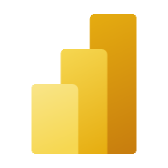




Microsoft Fabric
The unified data platform for the era of AI
Data
Factory
Synapse Data
Engineering
Synapse Data
Science
Synapse Data Warehousing
Real-Time Intelligence
Power BI
Industry Data Solutions
Real-Time Hub
OneLake
Purview

Slide 11
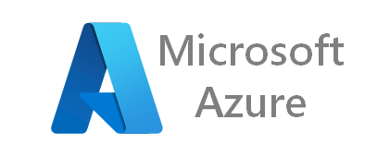


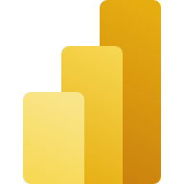
Real-Time Intelligence in Microsoft Fabric
Enterprise real-time data platforms
Self-service reporting and activation
Real-Time Intelligence
in Microsoft Fabric
Azure Event Hub
Azure Event Grid
Azure Stream Analytics
Azure Data Explorer
OneLake
Data Activator
Power BI
Fully integrated, no/low-code real-time SaaS data platform

Slide 12
Planet-scale infrastructure for real-time data
8 EB
3,000 T
Events and logs per month
Real-time events per month
4 B
2.8 B
Real-time queries per day
Endpoints streaming events
100 K
99.9992%
Customers using real-time data platforms
Success rate across messaging

Slide 13
Growth in data ingestion and processing
275 PB
Events and logs ingested daily
22 EB
Events and logs available for query
2.5 M
Unique stream processing jobs

Slide 14







Real-Time Intelligence in Microsoft Fabric
Event Ingestion
Real-Time Analytics
Real-Time Dashboards
Real-Time Triggers
Real-Time AI
Real-Time Applications
Event-Driven Actions
Data
Factory
Synapse Data
Engineering
Synapse Data
Science
Synapse Data Warehousing
Real-Time Intelligence
Power BI
Industry Data Solutions
Real-Time Hub
OneLake

Slide 15














Real-Time Intelligence in Microsoft Fabric
Process
Analyze
Monitor
Best-in-class Connectivity
Real-Time Hub
Act
OneLake
AI-powered Intelligence

Slide 16
Real-Time Intelligence in Microsoft Fabric
Complete Analytics Platform
Rapid app development
Real-time AI insights
Complete SaaS solution
Single data estate & open
Everything, unified
Everything, unified
Events out-of-the-box
Reuse of models
Non-obvious insights
SaaS-ified
SaaS experience
Open data format
Multi-tenant security
Automatic learning
Secured and governed
Lightweight modeling
Data rests in OneLake
Event pub-sub
Copilot acceleration

Slide 17
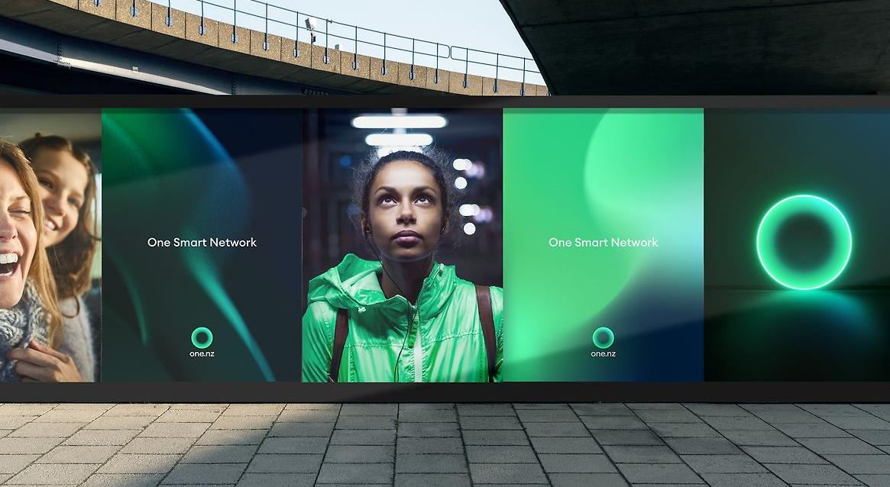

“
Previously, you needed to be a data engineer or scientist to access and understand customer information. Now we're making it user-friendly, so anyone can easily make data-driven decisions.
Strathan Campbell
Channel Environment Technology Lead, One NZ​
Notes:
Now, if a customer waits for 30 seconds, the operations team can immediately allocate an agent to that call. “Our previous target to answer an incoming call was 45 seconds. Now we're at 27 seconds, a significant improvement from our customers’ perspective,” shares Strathan.

Slide 18












Components of Fabric’s Real-Time Intelligence
Data Source(s)
Fabric
Real-Time Intelligence
Ingest & Process
Analyze & Transform
Act
Eventstream
Reflex
Eventhouse
Power BI
KQL Queryset
RT Dashboard
+ many more..
Real-Time Hub
OneLake
Notes:
Real-Time Intelligence allows organizations to ingest and process, analyze and transform, and automatically act on data. With a central hub, Real-Time Hub, to easily access and visualize all internal and external, first- and third-party streaming data, you can achieve faster, more accurate decision-making and accelerated time to insight.

Slide 19



Real-Time Intelligence in Microsoft Fabric
Ingest & Process
Analyze
Act
Streaming sources including AMQP, Kafka, Azure Event Hubs and more
No-code experience including event processing
Event routing to Eventhouse, Reflex and other Fabric entities
Timeseries database with unlimited scale (query, ingestion, storage)
Transformation on read of complicated data structure
Copilot for generating queries
Take actions automatically when patterns or conditions are detected
Light-weight modeling empowering the business user
Real-Time Hub
Central place to discover data and launch all related tasks

Slide 20
Demo Real-Time Hub
Notes:
https://aka.ms/VBDFabricRTIDemos

Slide 21
Real-Time Intelligence in Microsoft Fabric
Ingest & Process
Analyze
Act
Streaming sources including AMQP, Kafka, Azure Event Hubs and more
No-code experience including event processing
Event routing to Eventhouse, Reflex and other Fabric entities
Timeseries database with unlimited scale (query, ingestion, storage)
Transformation on read of complicated data structure
Copilot for generating queries
Take actions automatically when patterns or conditions are detected
Light-weight modeling empowering the business user
Real-Time Hub
Central place to discover data and launch all related tasks

Slide 22
Demo Eventstreams
Notes:
https://aka.ms/VBDFabricRTIDemos

Slide 23
Real-Time Intelligence in Microsoft Fabric
Ingest & Process
Analyze
Act
Streaming sources including AMQP, Kafka, Azure Event Hubs and more
No-code experience including event processing
Event routing to Eventhouse, Reflex and other Fabric entities
Timeseries database with unlimited scale (query, ingestion, storage)
Transformation on read of complicated data structure
Copilot for generating queries
Take actions automatically when patterns or conditions are detected
Light-weight modeling empowering the business user
Real-Time Hub
Central place to discover data and launch all related tasks

Slide 24
Demo – Eventhouse & Real-Time Dashboards
Notes:
https://aka.ms/VBDFabricRTIDemos

Slide 25
Real-Time Intelligence in Microsoft Fabric
Ingest & Process
Analyze
Act
Streaming sources including AMQP, Kafka, Azure Event Hubs and more
No-code experience including event processing
Event routing to Eventhouse, Reflex and other Fabric entities
Timeseries database with unlimited scale (query, ingestion, storage)
Transformation on read of complicated data structure
Copilot for generating queries
Take actions automatically when patterns or conditions are detected
Light-weight modeling empowering the business user
Real-Time Hub
Central place to discover data and launch all related tasks

Slide 26
Demo – Data Activator

Slide 27



Connected Factory
An end-to-end Real-Time Intelligence experience
Ingest & process
Over 1M/1 HR IIoT events, 30k tags, from 40 factories are streamed in real time with sub-second latency
Contextualization data (OPC asset metadata, shift details, weather, component cost, etc.) mirrored into Fabric OneLake
Analyze & transform
IIoT events are enriched in-motion with the Contextualization data and asset hierarchy from OneLake, providing clean and meaningful views
Enriched data is aggregated on the fly for long-term view
Train
Build, train, and score ML models in real time, persisting the scored data in OneLake
Visualize and activate
Real time dashboard of all factories with ability to easily shift from low granularity to high granularity view
Enhance organizational BI reports with high granularity enriched data
Notify users and activate automation in response to live indications from the factory floor
1
3
4
7
8
IoT Hub
Eventstream
Eventhouse
Power BI
Reflex
Azure IoT Operations
Eventstream
5
OneLake
Dashboard
ERP
2
Data Factory
ML model
6
Notes:
Let’s take a look at an end-to-end, Connected Factory experience with Real-Time Intelligence in Fabric.

Slide 28
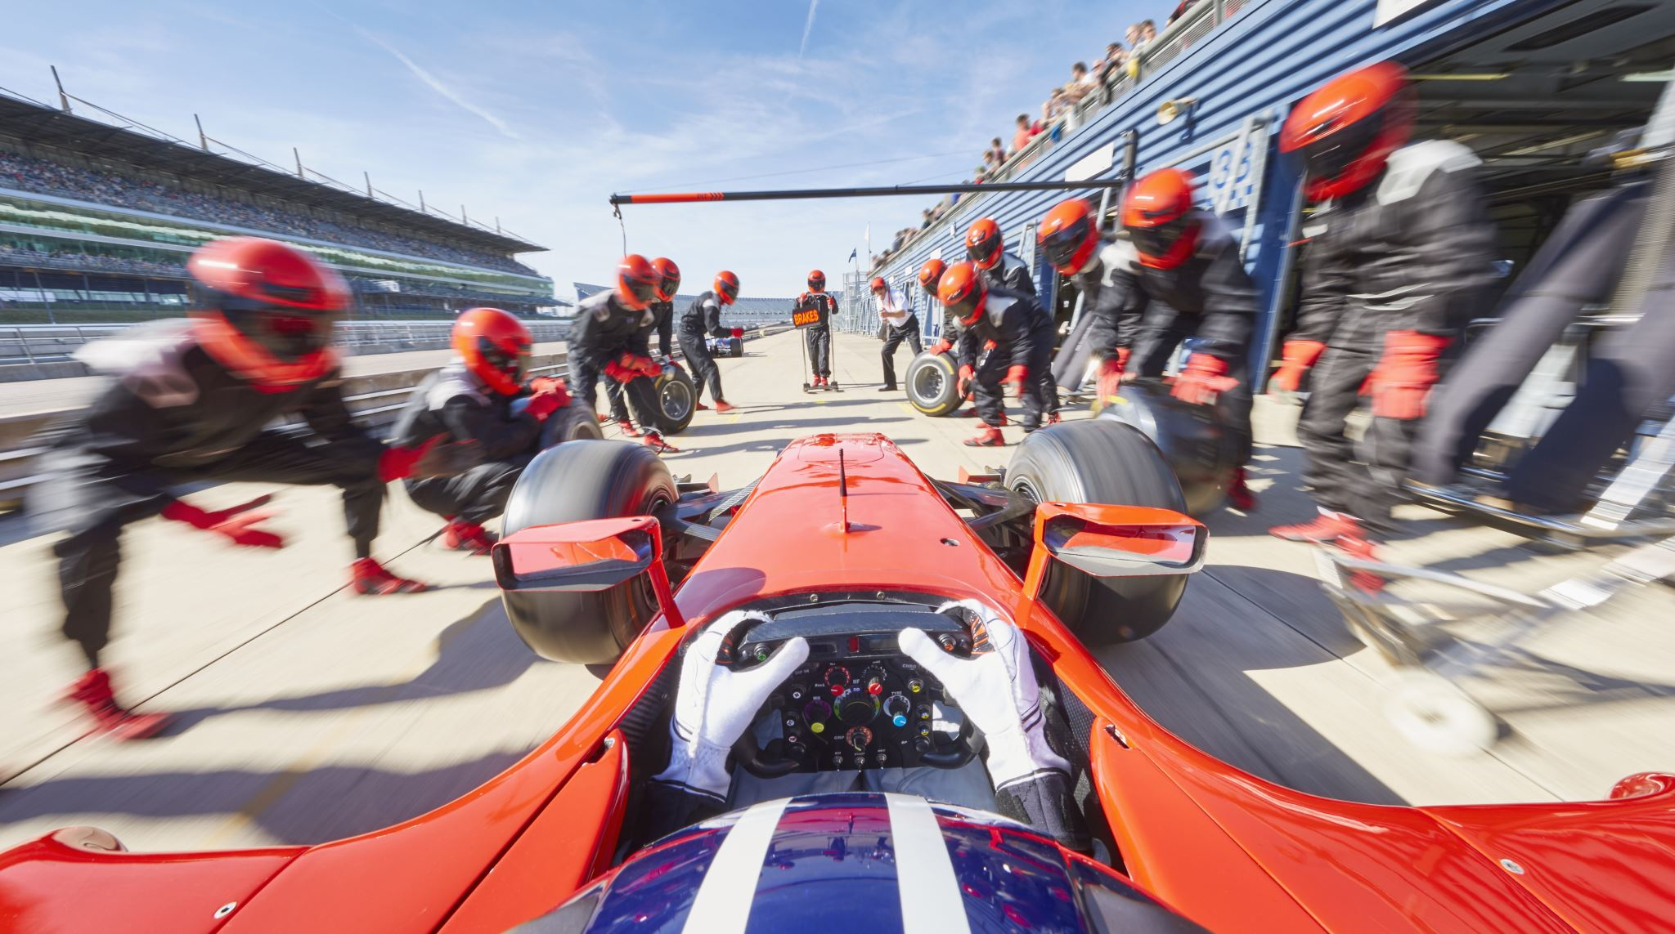

“
Before we used Microsoft Fabric and real-time analytics, it was probably 30 minutes before the engineers who knew that something was wrong with a car could get the data, analyze it, and have a result. Today the process is done within minutes.
Dener Pires
CEO, Dener Motorsport

Slide 29
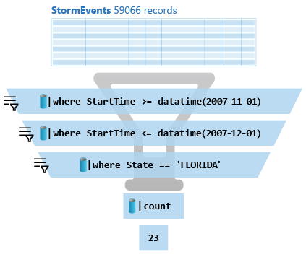





KQL Concepts
Relational operators
filters, union, joins, aggregations, …
Each operator consumes tabular input and produces a tabular output
Commands
Can be combined with ‘|’ (pipe)
Similarities
OS shell, Linq, functional SQL…
Agility
Queries are easy to write, read, change
Statements
Single statement query
Use ‘let’ for reusing statements
Multi-statement (‘;’) queries
Notes:
A Kusto query is a read-only request to process data and return results.
Has one or more query statements and returns data in a tabular or graph format.
Statements are sequenced by a pipe (|). Data flows, or is piped, from one operator to the next.
It's like a funnel, where you start out with an entire data table.
The data is filtered/manipulated at each step and then fed into the following step.
Each time the data passes through another operator, it's filtered, rearranged, or summarized.

Slide 30
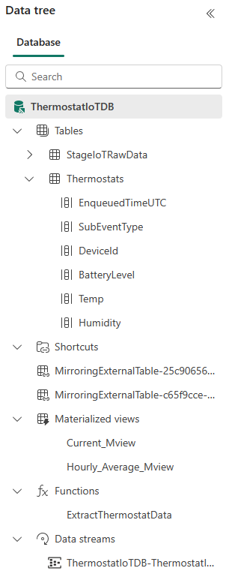
Schema
Schema is
Relational, Lightweight, Dynamic
Databases
Authorization boundary
Transaction boundary
But not query boundary!
Supporting cross-database and cross-cluster queries
Tables
Rectangular
Columns
Supported types: boolean, integer, real, decimal, dates, timespan, string, dynamic (JSON)
Shortcuts (external data)
Stored functions (views)
Materialized views

Slide 31
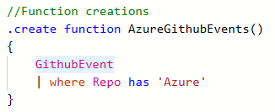
Stored Functions (stored procedures/views)
Functions
Reusable script, defined and used in a Database scope
View
parameter-less function
Schema
Scalar or tabular
Special powers
A function can have the same name as a table
Safe and Secure
Control commands are forbidden.
Applications
Sharing queries between users/applications
Abstracting complex logic from other applications
SQL-compat tools connecting to Kusto via Views to run high-performance queries
Notes:
Learn more: User-defined functions - Azure Data Explorer & Real-Time Analytics | Microsoft Learn
Functions - Azure Data Explorer & Real-Time Analytics | Microsoft Learn .create function command - Azure Data Explorer & Real-Time Analytics | Microsoft Learn

Slide 32
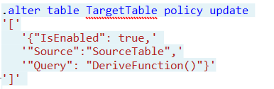
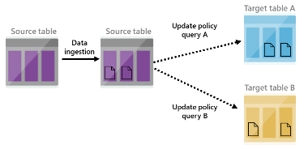
Update Policy (mini-ETL/Trigger)
Essentially
Triggered ingestion into another table.
Semantics
Attached on "target" table and points to "source" table. Transformation is an arbitrary Kusto query
Special powers
Source table is scoped to the newly ingested data only
Applications
Transform data schema (lightweight ETL)
De-multiplexing data stream into several tables
Use target tables with longer retention
Reduce duplicates
Notes:
<Gilles> Update policy is like an internal ETL. It can help you manipulate or enrich the data as it gets ingested into the source table (e.g. extracting JSON into separate columns, creating a new calculated column, joining the new records with a static dimension table that is already in your database, etc). For these cases, using an update policy is a very common and powerful practice. Each time records get ingested into the source table, the update policy's qeury (which we'll define in the update policy) will run on them (and only on newly ingested records - other existing records in the source table aren’t visible to the update policy when it runs), and the results of the query will be appended to the target table.
When you trigger an update policy with a command that adds data to a source table, data also appends to a target table. The target table can have a different schema, retention policy, and other policies from the source table. For example, a high-rate trace source table can contain data formatted as a free-text column. The target table can include specific trace lines, with a well-structured schema generated from a transformation of the source table's free-text data using the parse operator.
Performance impact
Update policies can affect cluster performance, and ingestion for data extents is multiplied by the number of target tables. It's important to optimize the policy-related query. You can test an update policy's performance impact by invoking the policy on already-existing extents, before creating or altering the policy, or on the function used with the query.

Slide 33
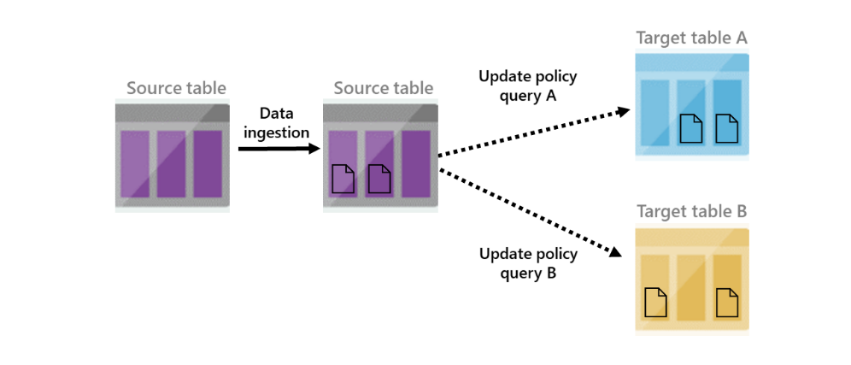
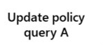

Update Policy
IngestionLogs (244854 records)
ManiputatelogsRaw() filters the newly ingested data
logsRaw
logsRaw + new 3834012 ingested records (not filtered)
Notes:
<Gilles> Source table 'logsRaw' must be referenced in update policy query
Update policy is like an internal ETL. It can help you manipulate or enrich the data as it gets ingested into the source table (e.g. extracting JSON into separate columns, creating a new calculated column, joining the new records with a static dimension table that is already in your database, etc). For these cases, using an update policy is a very common and powerful practice. Each time records get ingested into the source table, the update policy's qeury (which we'll define in the update policy) will run on them (and only on newly ingested records - other existing records in the source table aren’t visible to the update policy when it runs), and the results of the query will be appended to the target table.
When you trigger an update policy with a command that adds data to a source table, data also appends to a target table. The target table can have a different schema, retention policy, and other policies from the source table. For example, a high-rate trace source table can contain data formatted as a free-text column. The target table can include specific trace lines, with a well-structured schema generated from a transformation of the source table's free-text data using the parse operator.
Performance impact
Update policies can affect cluster performance, and ingestion for data extents is multiplied by the number of target tables. It's important to optimize the policy-related query. You can test an update policy's performance impact by invoking the policy on already-existing extents, before creating or altering the policy, or on the function used with the query.

Slide 34
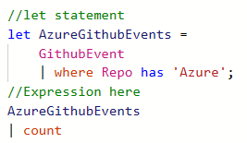
Let statements
Essentially
Named expression or function, defined and used in a query scope
Usage
let foo = T | where … ;
let bar = (val:string) { … };
Schema
Scalar or tabular
Special powers
Can override table / stored function with the same name
Applications
Reusing language expressions
Mid-tier exposing Logical Model (see also: restrict)

Slide 35
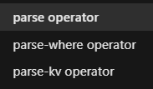
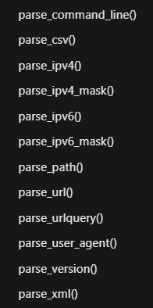
Parsing
Parsing Can be done with regular expressions as well as with native functions for specific data types and patterns
Parsing operators
Return data in columns
Parsing functions
Return dynamic objects using JSON notation
Applications
Parse complex JSON, XML documents
Extract IP addresses, URLs
Extract key-value pairs
Notes:
<Guy>

Slide 36
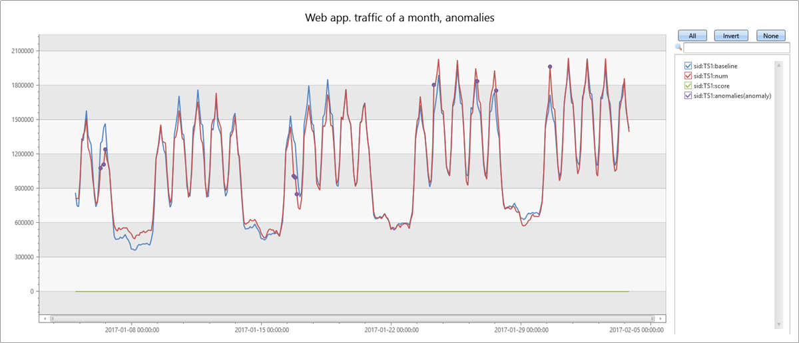
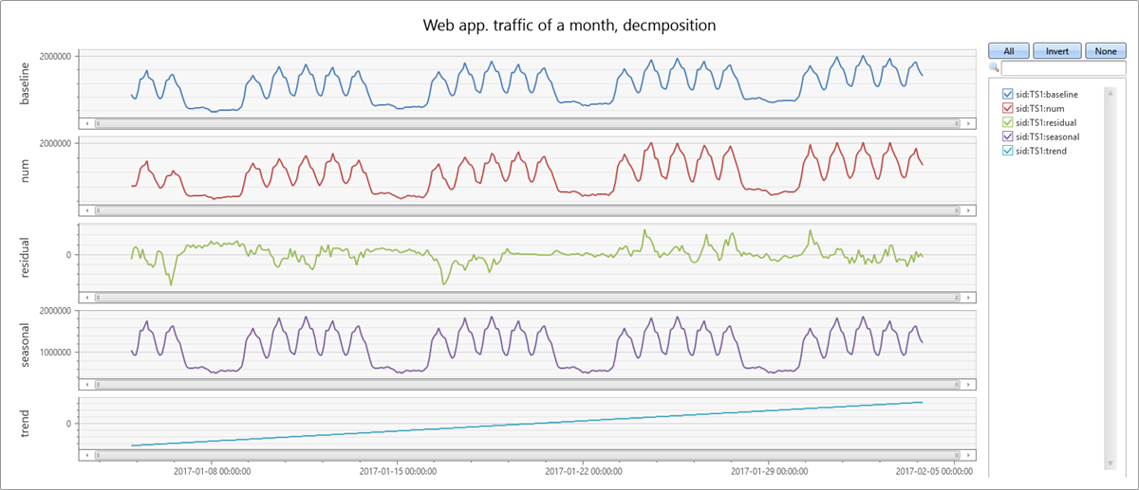
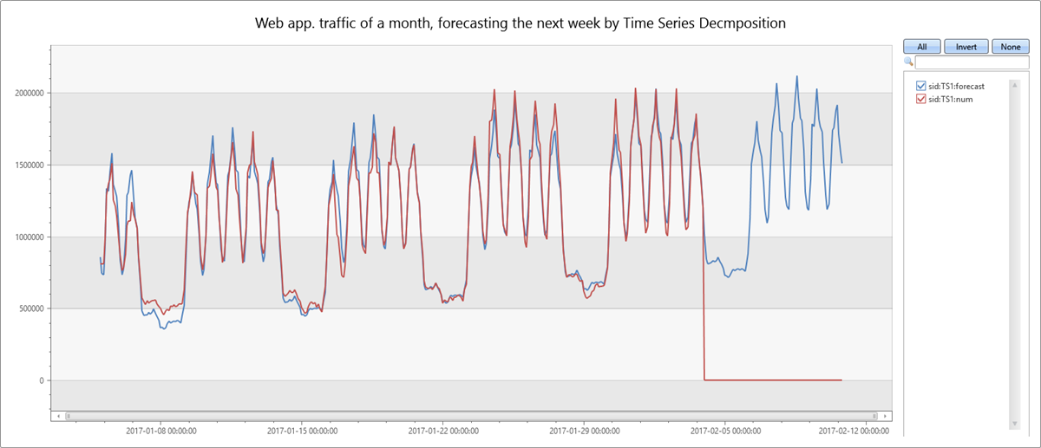
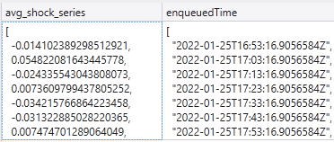
Time Series Analysis
make-series
Operator for creating set of (time) series
Large family of functions can be applied
Element-wise operations
Filtering (signal processing)
Statistics
Regressions
Seasonality detection/validation
Anomaly Detection
Forecasting
mv-apply operator
Optimized for bulks of time series
Notes:
<Hiram>
ADX performs on-going collection of telemetry from cloud services or IoT devices. This data can be analyzed for various insights such as monitoring service health, physical production processes, and usage trends. Analysis is done on time series of selected metrics to find a deviation in the pattern compared to its typical baseline pattern.
From <https://learn.microsoft.com/en-us/azure/data-explorer/kusto/query/time-series-analysis>
simply and intuitively using the make-series operator, and fill-in missing values as needed
Element-wise functions: Arithmetic and logical operations can be done on a time series. Using series_subtract() we can calculate a residual time series, that is, the difference between original raw metric and a smoothed one, and look for anomalies in the residual signal.
Filtering - smoothning a noisy signal, change detection, simple calc of moving average and differentiation. ie. Series_fir(), series_iir(), bins (s/m/d)
Statistics - percentile, standard deviation, mean/min/max/avg/count.
Regressions, segmented linear regression to estimate the trend. series_fit_line() - fit the best line, series_fit_2lines(), detect changes relative to baseline.
Seasonality - auto detect periods/clusters, series_periods_detect(), series_periods_validate() - check if a metric has a specific period and we want to verify they exists.
Anomaly detection - uses series_decompose() and series_outiers() on the residual. Finds seasonal, trend, residual, and baseline. Calculates anomalous points using Tukey's fence test. Control threshold sensitivity. Forecasting is done by extrapolating the seasonal and trend components.
mv-apply operator Applies a subquery to each record, and returns the union of the results of all subqueries. From <https://learn.microsoft.com/en-us/azure/data-explorer/kusto/query/mv-applyoperator>
What is time series analysis?
Time series analysis comprises methods for analyzing time series data in order to extract meaningful statistics and other characteristics of the data. Time series forecasting, for example, is the use of a model to predict future values based on previously observed values.
What is time series decomposition? Time series decomposition involves thinking of a series as a combination of 4 components:
trends (increasing or decreasing value in the series)
seasonality (repeating short-term cycle in the series)
baseline (the predicted value of the series, which is the sum of seasonal and trend components)
noise (The residual random variation in the series). We can use built in functions, that uses time series decomposition to forecast future metric values and/or detect anomalous values.
This is what time series looks like: <click>
Why should you use series instead of the summarize operator ? The summarize operator does not add "null bins"—rows for time bin values for which there's no corresponding row in the table. Advanced built in ML capabilities like anomaly detection, need the data points to be consistently measured at equally spaced intervals, so we have to "pad" the table. The make-series can create such a “complete” series.

Slide 37

Python plugin
KQL extensibility with inline Python
Python engine (sandbox)
Runs on secure local containers on same Kusto engine nodes
Image
Based on Anaconda 5.2.0 + popular packages (tensorflow, keras, torch and more)
Execution
Single node (default) or distributed processing
Extensible
Ability to install custom packages.
Edit & debug in VSCode (client-side integration)
Scalability
Support for scoring with big ML models
Notes:
<Hiram>
DEMO
Here's the KQL script I demo'ed: ADXIoTAnalytics/ADXInADay-DemoML.kql at main · Azure/ADXIoTAnalytics (github.com)
This KQL script includes options and addition ML training guides: ADXIoTAnalytics/M06-Demo5-TrainModel.kql at main · Azure/ADXIoTAnalytics (github.com)

Slide 38
ML Connectivity
Notebooks with Kqlmagic library
Connect multiple clusters (Kusto, Log Analytics, App Insights). Create rich interactive notebook with Kusto and Python. Use out-of-the-box integration with Python libraries.
Python & R Client SDKs
Access data from Kusto using Python or R libraries
Spark connector
Read data or write data to Kusto using Scala and PySpark
Parquet support
Ingest parquet files from Blob/Data Lake. Export data to Blob/Data Lake as parquet files (with partitioning support)
External tables
Query parquet files from data lake as external
Notes:
<Hiram>

Slide 39
Lab Guidelines
Combination of labs and open-hack. Use the links, hints, try to solve, or raise your hands.
Screenshots are just examples. Your output may not exactly match the screenshots provided.
Please read the instructions carefully.
Badging is yet to-be-determined. Badges for quiz completions are currently not issued.
We will help everyone complete the Labs.
https://aka.ms/FabricRTAinaDay > start with Lab1.md

Slide 40

https://aka.ms/FabricRTAinaDay
Quizzes can be re-attempted, and will help guide your answers
Lab 1
Lab 1 Quiz
Lab 2
Lab 2 Quiz
Notes:
Repo: https://aka.ms/FabricRTAinaDay > Lab1.md > Lab2.md
Lab 1 quiz: https://forms.office.com/r/bV9RCiLVuJ
Lab 2 quiz: https://forms.office.com/r/fpSN0r7QLt

Slide 41


Microsoft Fabric
The unified data platform for the era of AI
Data
Factory
Synapse Data
Engineering
Synapse Data
Science
Synapse Data Warehousing
Real-Time Intelligence
Power BI
Industry Data Solutions
Real-Time Hub
OneLake
Purview
https://aka.ms/realtimeanalytics

Slide 42
Thank you!

